Slide 1
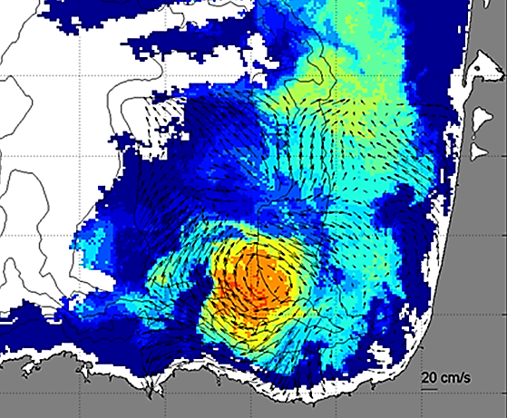
DAY 2 Session HF Radar in Europe
Outline of the project
INCREASE: Innovation and Networking for the integration of Coastal Radars into European mArine Services
J. Mader, A. Rubio, J.L. Asensio, A. Caballero (AZTI); A. Novellino, M. Alba (ETT); C. Mantovani, L. Corgnati, A. Griffa (CNR-ISMAR)
Contact: jmader@azti.es
CMEMS Service Evolution 21-SE-CALL1
Lot5: INCREASE project
Innovation and Networking for the integration of Coastal Radars into European mArine SErvices

Slide 2
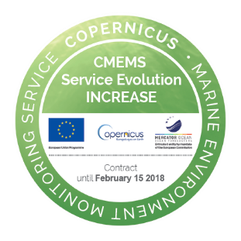
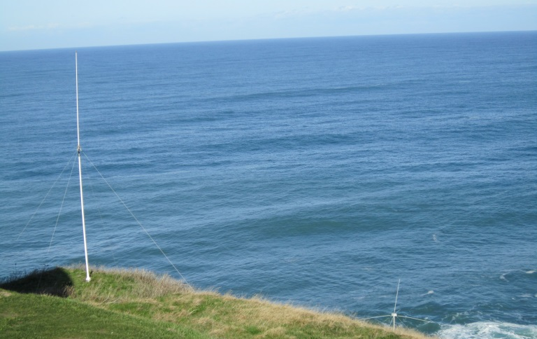

Outline
    INCREASE objectives and work plan
    Progress (methods, results and communication)
    Transfer towards CMEMS
THE COPERNICUS MARINE WEEK
Brussels,
26 September 2017
DAY 2 Session
9:00-13:00
HF Radar in Europe
CMEMS Service Evolution 21-SE-CALL1
Lot5: INCREASE project
Innovation and Networking for the integration of Coastal Radars into European mArine SErvices

Slide 3
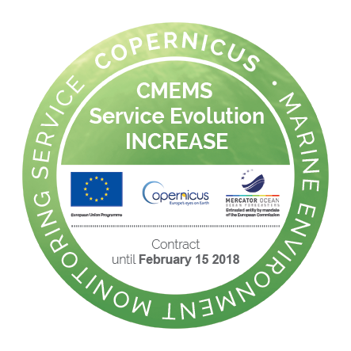
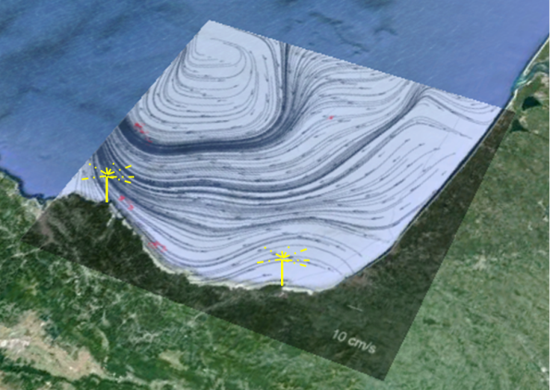
INCREASE objectives and work plan
Innovation and Networking for the integration of Coastal Radars into European mArine SErvices
INCREASE aims to set the necessary developments for the integration of the existing European HFR operational systems into the CMEMS, following four main objectives:
Provide HFR quality controlled real-time surface current data for direct use and through key derived products (gap-filled data, filtered data, short-term prediction and derived Lagrangian products)
Set the basis for the management of historical data and methodologies for reprocessing existing data sets, using advanced delayed mode quality-control techniques, to obtain the best possible continuous surface coastal ocean observations
Boost the use of HFR data for improving CMEMS numerical modeling systems, through validation, model-data blending and data assimilation.
Enable an HFR European operational node to ensure the operational availability of HFR data and data products and the link with operational CMEMS

Slide 4
INCREASE objectives and work plan
WP1: Towards the integration of HFR observing technology into CMEMS
  M1.1; D1.1: Report on European HFR systems development and roadmap for HFR products evolutions in compliance with CMEMS needs
WP2: Basis for HFR data assimilation into CMEMS models;
  M2.1; D2.1 :Guidelines towards increasing HFR data assimilation capacities into CMEMS
WP3: HFR Products development;
  M3.1-2: Basic and advanced products v0 are ready;
  D3.1: Protocols on QA best practices, QC for radial and total data ;
  D3.2: Tool for interoperable radial and total data production, tool for combination of radial data with different spatial resolutions
WP4: HFR Node;
  M4.1: HFR Node working infrastructure;
  D4.1: Recommendation and guideline to set up the hardware and software tools to provide HFR data to the HFR Node
WP5: Coordination;M5.1:Online KOM;
  M5.2: HFR expert WS;
  M5.3+5: Mid-term /final review meeting CMEMS (MFC+TAC);
  M5.4: Implementation expert users WS (CMEMS users);
  D5.1-4 :Reports, minutes
  Main specific objectives:
  WP1-WP5 → To bring CMEMS and HFR community closer
  WP2 → To bring information to modelers (CMEMS and CMEMS users)
  WP3 → To perform show cases with HFR products
  WP4 → Paving the way towards a HFR Node

Slide 5
WP1: Towards the integration of HFR observing technology into CMEMS
Objectives:
O1.1 Make a diagnostic of the present development of European HFR systems with respect to CMEMS needs and towards the establishment of a European HFR network (existing systems, existing products, operators);
O1.2 Set the methodology for specific processing and mapping of product uncertainties following world class processing and calibration/correction, for operational direct use;
O1.3 Set the methodology for reprocessing of existing data sets with advanced quality control methods;
O1.4 Roadmap for the production of additional physical variables from HFR (wave, wind data)
Description of Work
T1.1. Detailed up-to-date inventory of the operational HFR systems (and operators), HFR data bases, HFR data uses and users (O1.1);
T1.2. Review and methodology selection to develop the basic products (QA/QC radial and total data) (O1.2);
T1.3. Review and methodology selection to develop the advanced products (QA/QC refined grid products, gap-filled products, short term prediction and Lagrangian products) (O1.3, O1.4).

Slide 6
WP2: Basis for HFR data assimilation into CMEMS models
Objective
The main objected is to set the basis for HFR data assimilation into CMEMS models:
O2.1 Development of a capacity to assimilation new/novel HFR observations;
O2.2 Development of community tools and diagnostics
Description of Work
T2.1. Methodology and assessment of HFR current data uncertainties (O2.1);
T.2.2. Methodology and assessment of HFR observation capabilities and limitations (O2.1);
T.2.3. Review of the state of the art on Assimilation methodologies. Define the roadmap for the assimilation of HFR data in CMEMS(O2.1) ;
T.2.4 Work jointly with the assimilation community to define specific products /protocols for assimilation purposes(O2.2)

Slide 7
WP3: HFR Products development
Objectives:
O3.1. Development of basic products to feed In situ TAC
O3.2. Development of advanced products to feed In situ TAC
Description of Work
T3.1 Basic product development and update (O3.1)
T3.2 Advanced product development and update (O3.2)

Slide 8
WP4: HFR Node
Objectives:
O4.1 Design and develop the hardware and software infrastructure for HFR data management;
O4.2 Develop and disseminate a common method for data formats, file conventions, file dimension, file naming and labelling for both real time (i.e. the continuous data flow for latest days) and historical (i.e. the complete series) HFR data ;
O4.3 Set up THREDDS catalogues
Description of Work
T4.1. Definition of the structure of a minimum core data to be disseminated, such as raw and processed data (O4.1);
T4.2. Definition of a core package of metadata for the standard data (O4.2);
T4.3. Design of the data distribution and interoperability via the CMEMS ISTAC infrastructure and EMODnet Physics portal (O4.3)

Slide 9
WP5: Coordination
Objectives:
O5.1 Ensure effective coordination to ensure the progress of the project and the production of the deliverables and the completion of the milestones;
O5.2 To integrate the European expertise in the definition of products and set of methodologies;
O5.3 To ensure the coordination with CMEMS coordinators for boosting the impact of the results of INCREASE and organizing future implementation;
O5.4 To promote the use of HFR data amongst a wide user community
Description of Work
T5.1. Production of mid-term and final reports (O5.1);
T5.2 Organization of two workshops and communication events (O5.3, O5.3) ;
T5.3 Communication (O5.4)

Slide 10
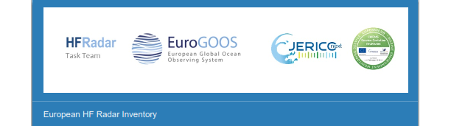
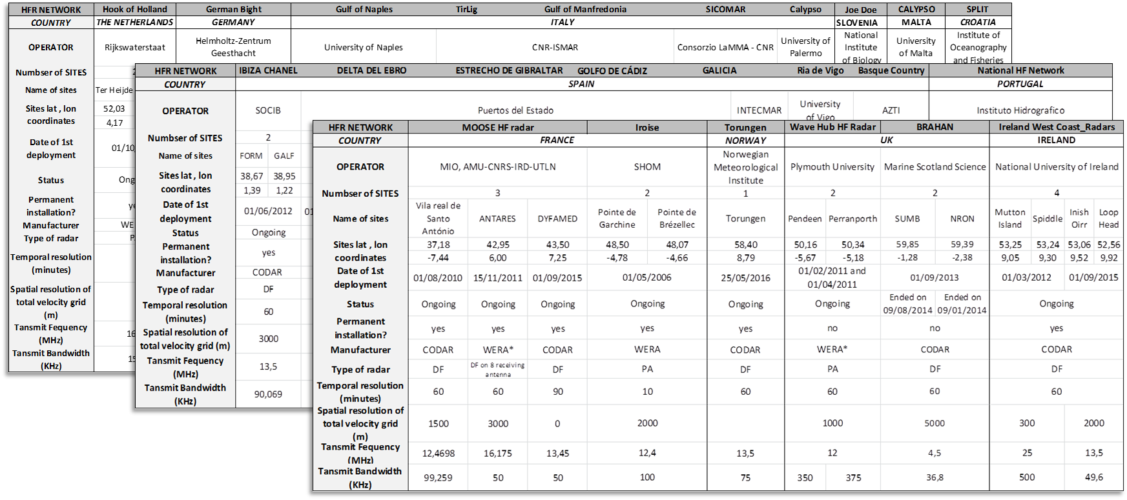
WP1: Towards the integration of HFR observing technology into CMEMS
The SURVEY
    HFR systems operation and maintenance
    Existing data formats and QA/QC protocols
    HFR surface ocean current data sharing protocol
    Use of the HFR for data assimilation
    HFR current data uses and users
REFERENCES:
Mader et al. (2016). The European HF Radar Inventory, EuroGOOS publications
(Available at http://eurogoos.eu/download/publications/EU_HFRadar_inventory.pdf)
Rubio et al. (2017). HF Radar Activity in European Coastal Seas: Next Steps toward a Pan-European HF Radar Network. Front. Mar. Sci. 4:8. doi: 10.3389/fmars.2017.00008
Joint Efforts Towards European HF Radar Integration - https://agu.confex.com/agu/fm16/meetingapp.cgi/Paper/174583

Slide 11
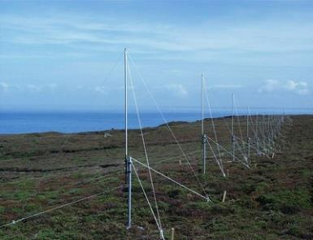
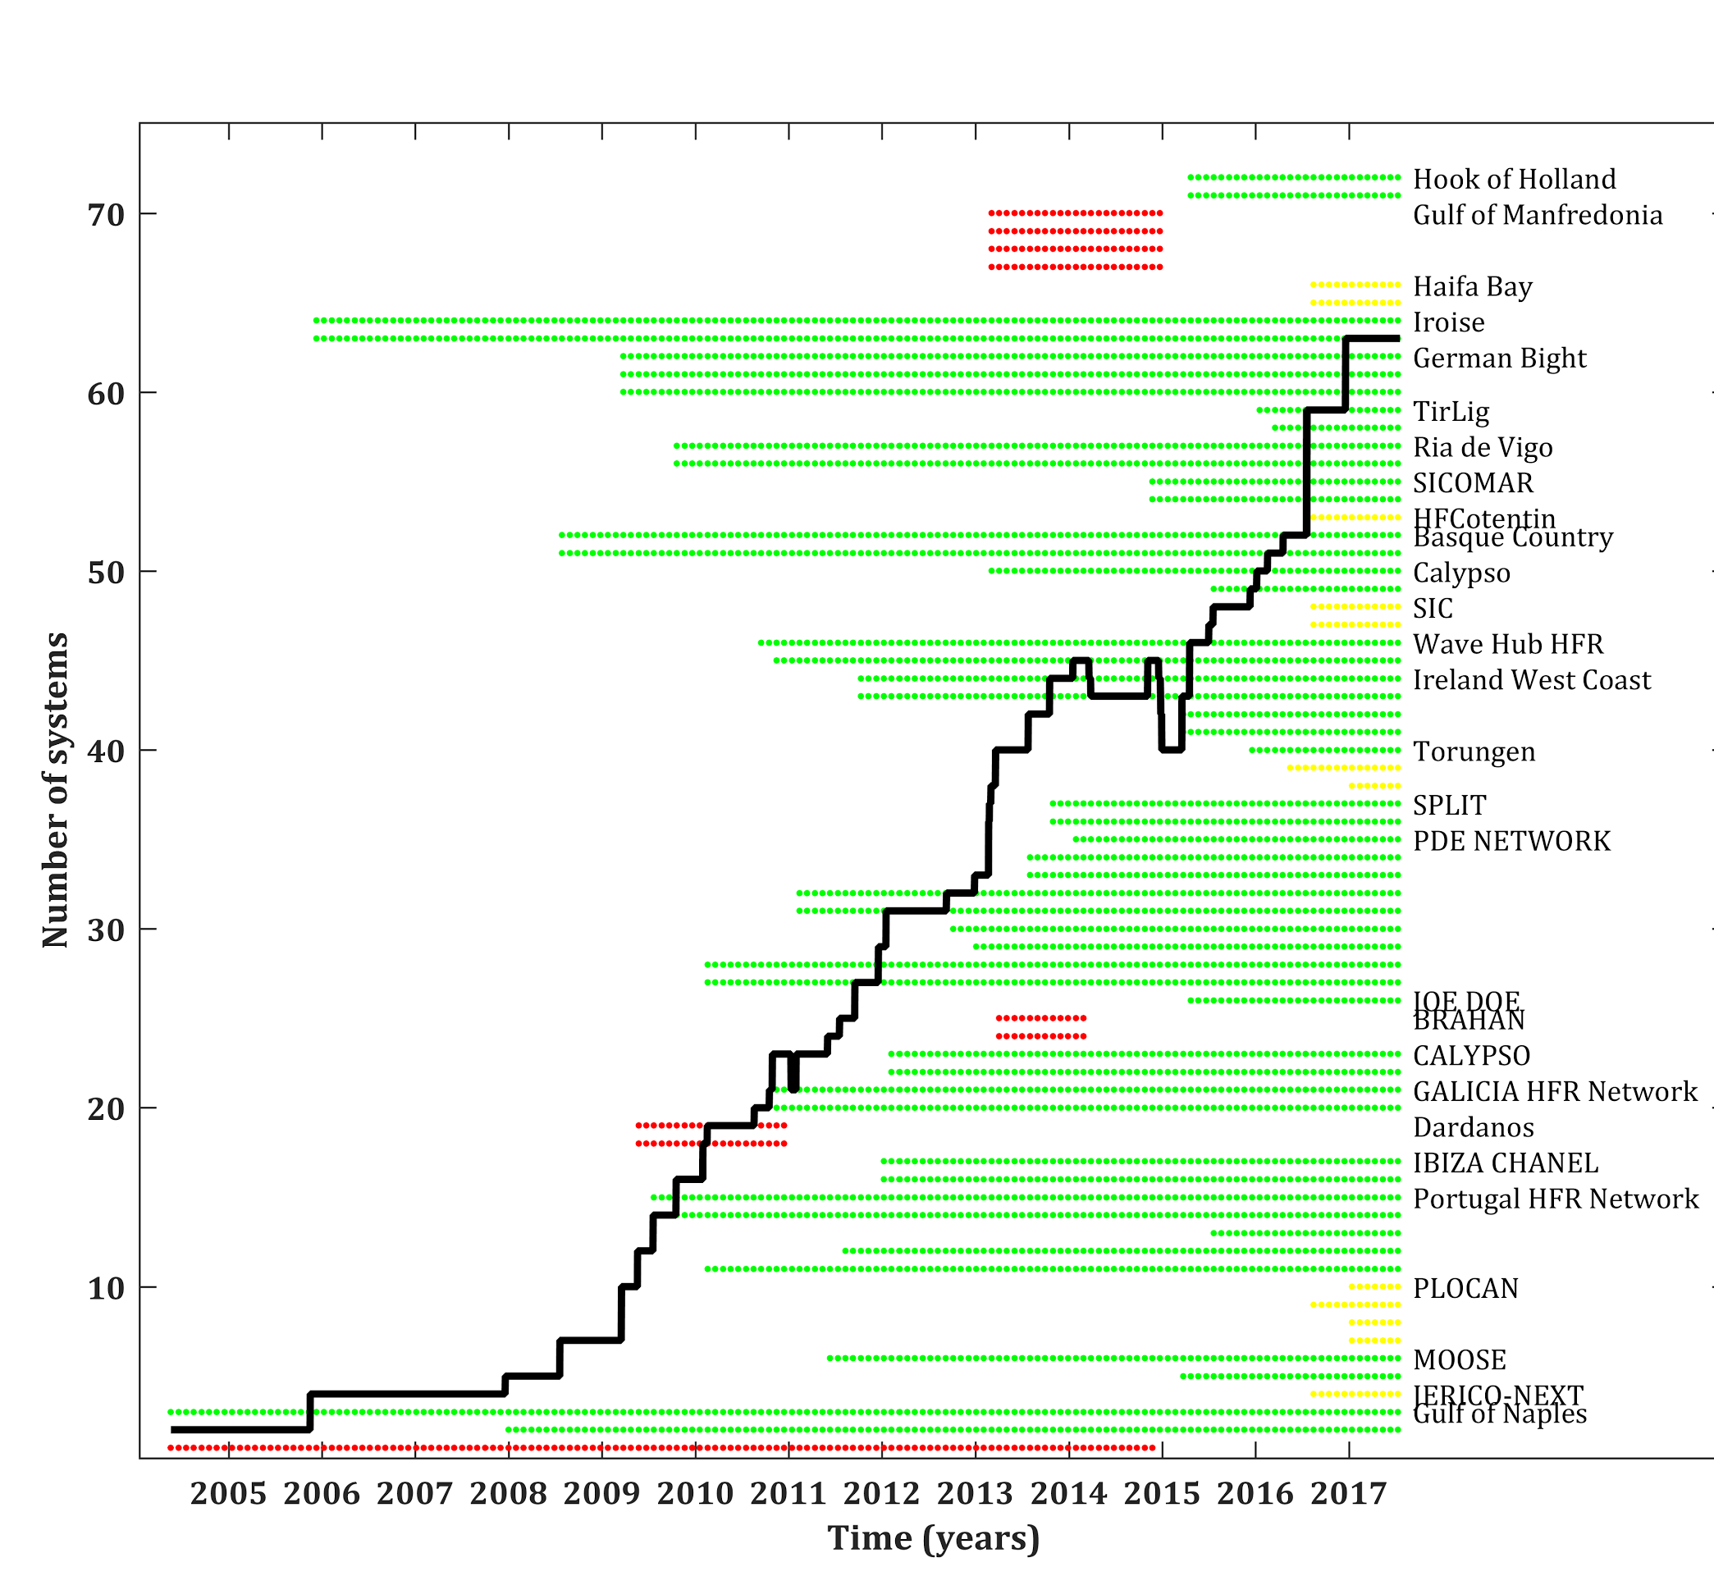
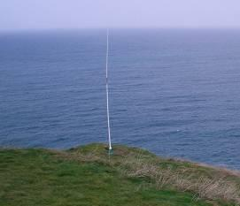
Information from 28 institutions, 23 operators of ongoing or past HFR networks.
72 sites (28 networks), 51 operational (20 networks).
Distribution of operational networks
50% (10 networks) in MONGOOS
30% (6 networks) in IBIROOS
20% (4 networks) in NOOS

Slide 12
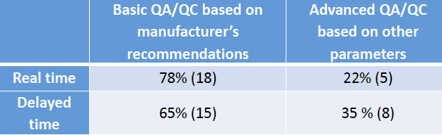
Information from 28 institutions, 23 operators of ongoing or past HFR networks.
72 sites (28 networks), 51 operational (20 networks).
HFR Data for assimilation in operational model:
26% of the operators are using data for assimilation in operational model (N=23).
72% are planning data assimilation (DA) exercises (50% radials – 50% totals).

Slide 13
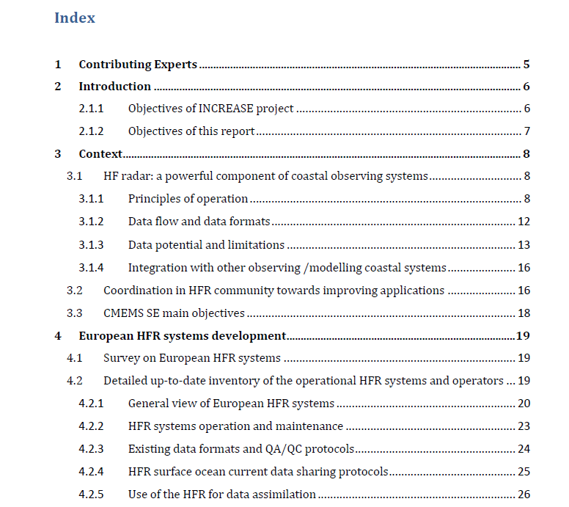
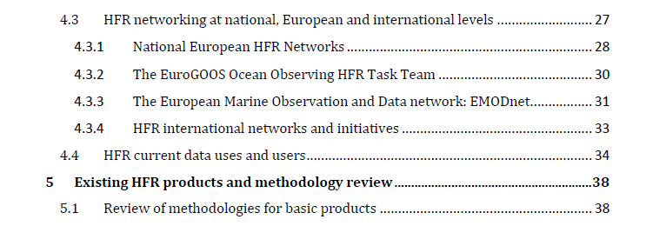
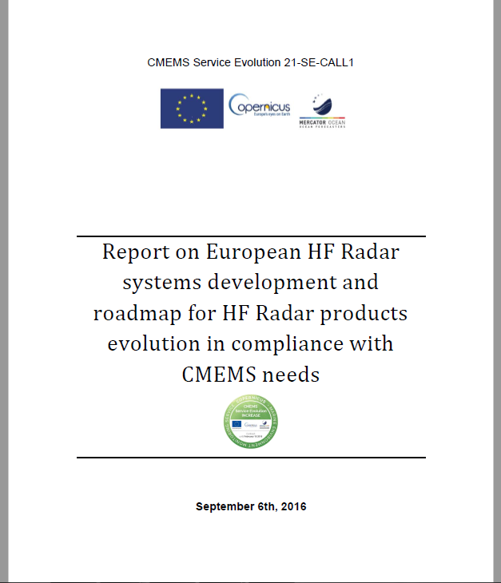
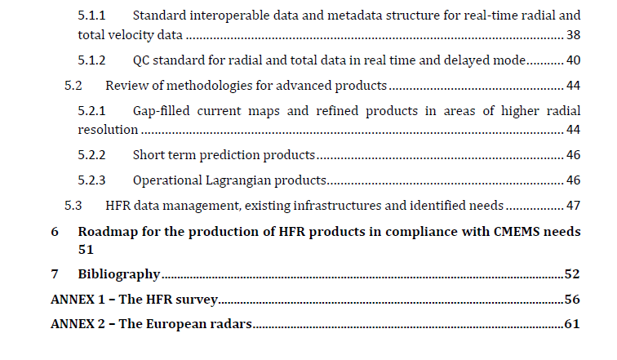
WP1: Towards the integration of HFR observing technology into CMEMS

Slide 14
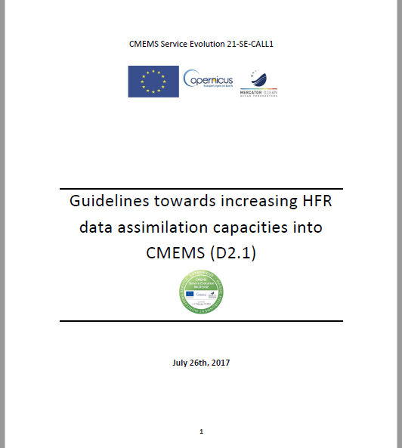
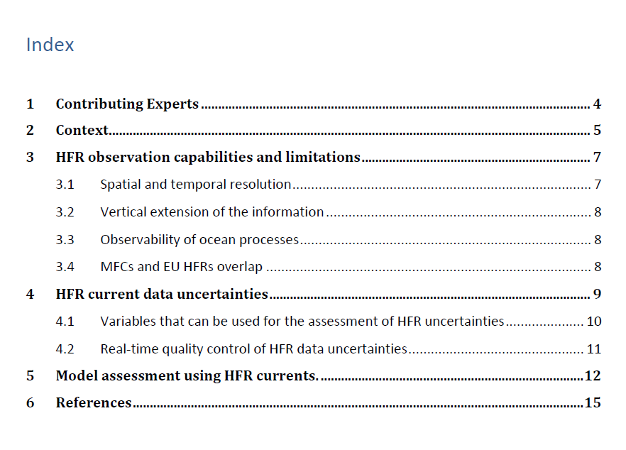
WP2: Basis for HFR data assimilation into CMEMS models

Slide 15
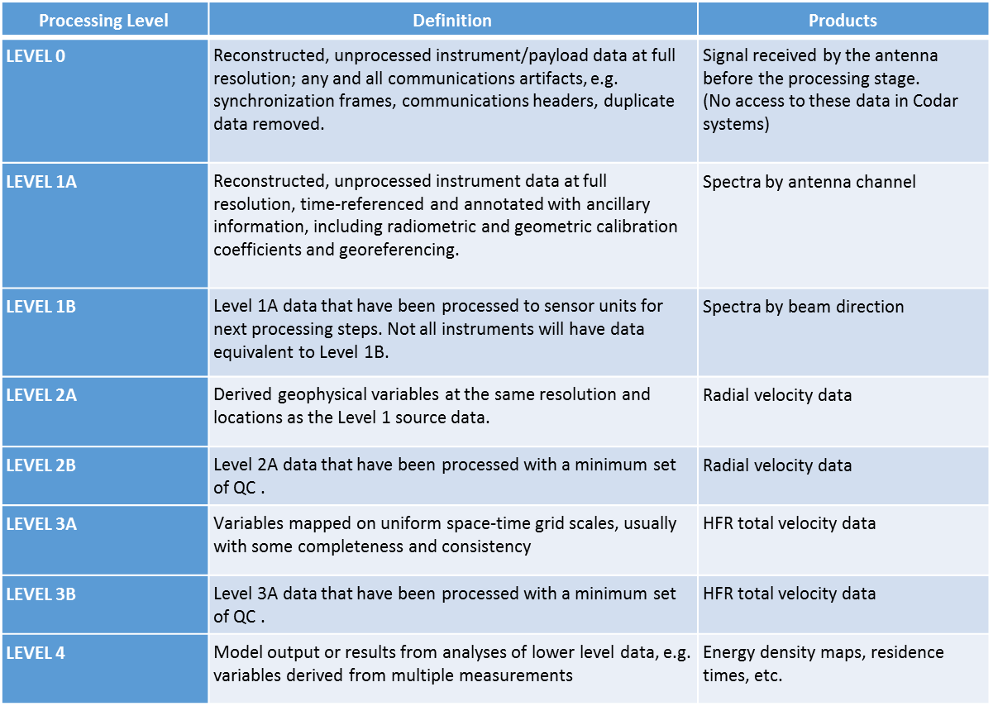
WP3: HFR Products development
Analysis of four key points for achieving a common consensus and set up a roadmap:
Data format
Metadata structure
QC flagging scheme
QC tests
Final scheme of processing levels for HFR
Coordination with networking and homogenizing activities of JERICO-NEXT (D5.13)

Slide 16
WP3: HFR Products development
Basic products: data format and QA/QC in compliance with CMEMS needs
data format | metadata structure | QC flagging scheme | QC tests
netCDF-4 data, and netCDF-3.6.1. CMEMS IN-SITU TAC archiving strategy and folder structure, CMEMS IN-SITU TAC naming convention. Data var names: SeaDataNet P09* | Mandatory Attr. to comply with CF-1.6 and OceanSITES conventions. Recommended Attr. to comply with INSPIRE and Unidata Dataset Discovery conventions. Suggested Attr. relevant in describing the data, whether it is part of the standard or not. | CMEMS IN-SITU TAC –OceanSITES: O. unknown, no QC 1. good, all QC passed 2. probably good, 3. Probably correctable, data used without scientific correction/calibration 4. Bad data, one or more QC failed 7. Nominal value, data not observed but reported 8. interpolated value 9. Missing value | chosen among the ones listed in the QARTOD manual. are manufacturer-independent, i.e. they do not rely on particular variables or information provided only by a specific device. defined for both radial and total velocity data required for labelling the data as Level 2B (for radial velocity) and Level 3B (for total velocity) data.
*) to be updated with HFR related variables

Slide 17
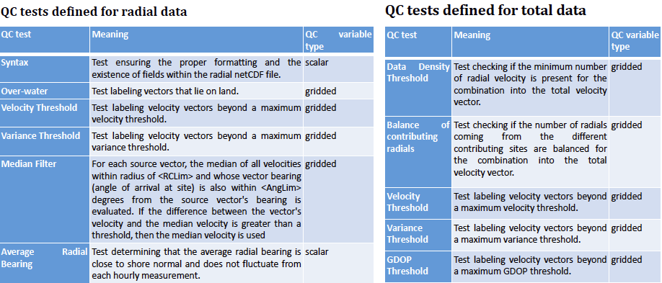
WP3: HFR Products development

Slide 18
WP3: HFR Products development
Advanced product development and update
Data gap filling and refined grid products | Short term prediction | Lagrangian products
Needed for key applications (using a Lagrangian Particle-Tracking Model (LPTM) Gap filling by Open Mode Analysis (OMA)¹ from radials or Variational Analysis² to provide accuracy estimations also on the gap-filled products Product to come together with total current field without data gap-filling | Simple approaches e.g. empirical models to forecast future currents based on a short time history of past observations Products of interest for Marine Services - SAR and oil spill apps methods to be tuned up on the geographical areas of application («predictable» patterns). | trajectory predictions using currents derived from HFR Lagrangian particle transport model … Not for CMEMS catalogue but as downstream application
1) Lekien et al., 2004, Kaplan and Lekien, 2007
2) Yaremchuk and Sentchev, 2009

Slide 19
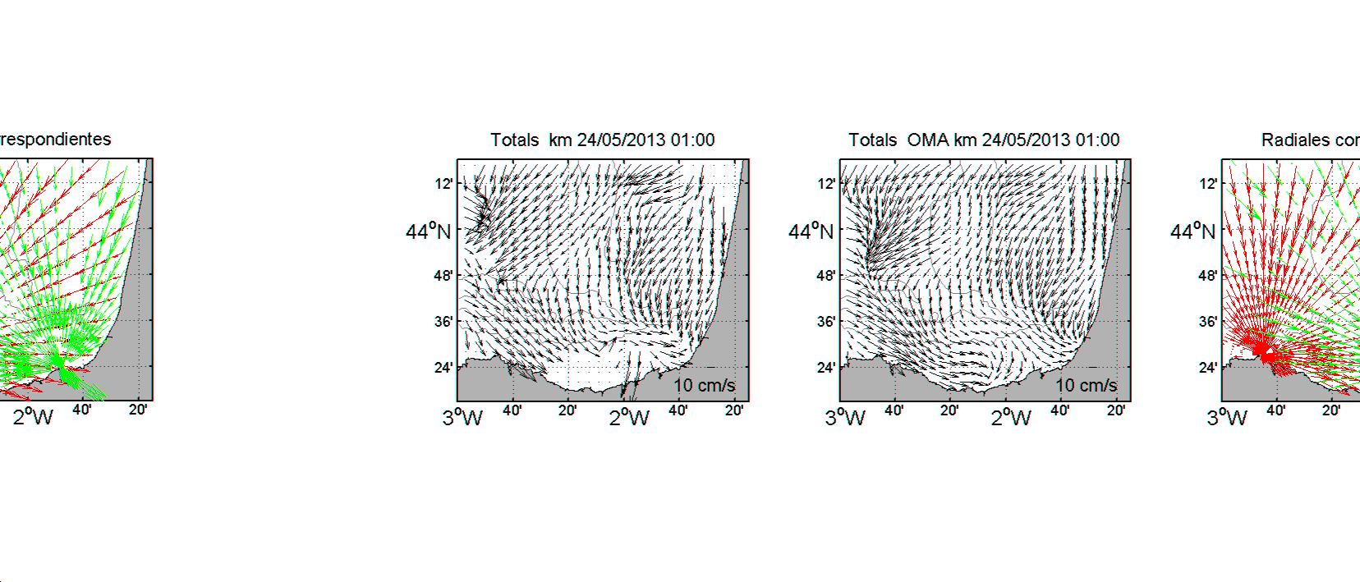
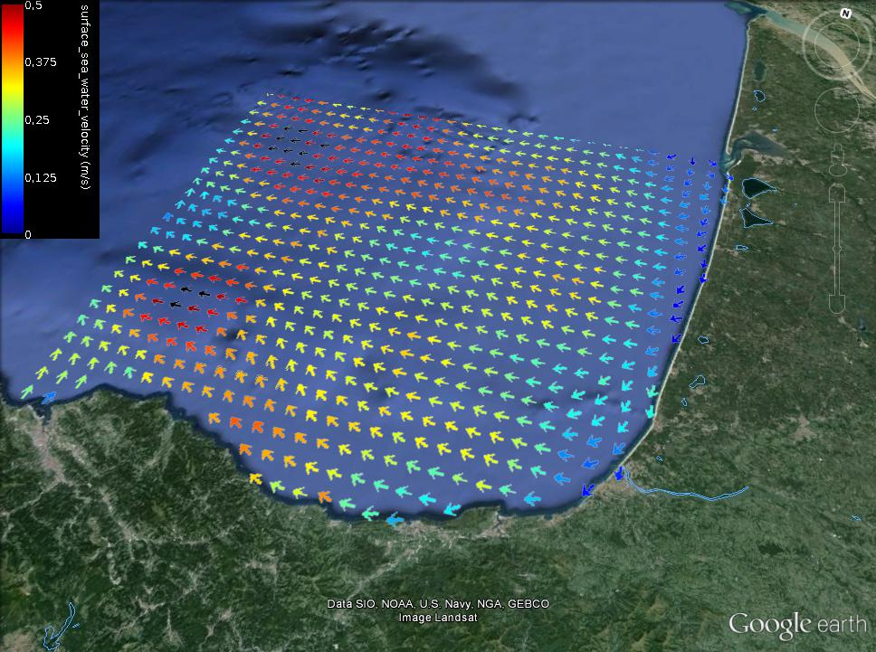
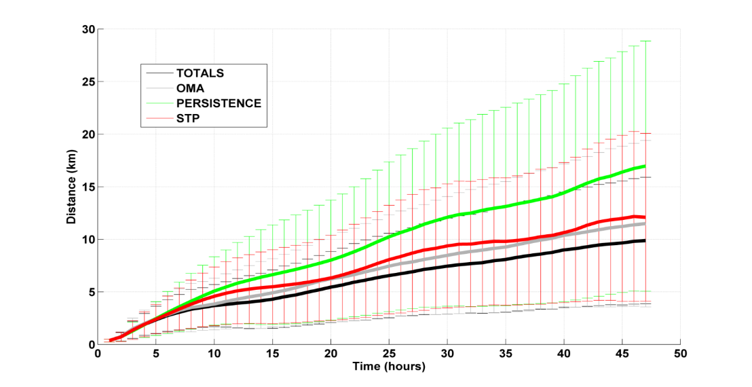
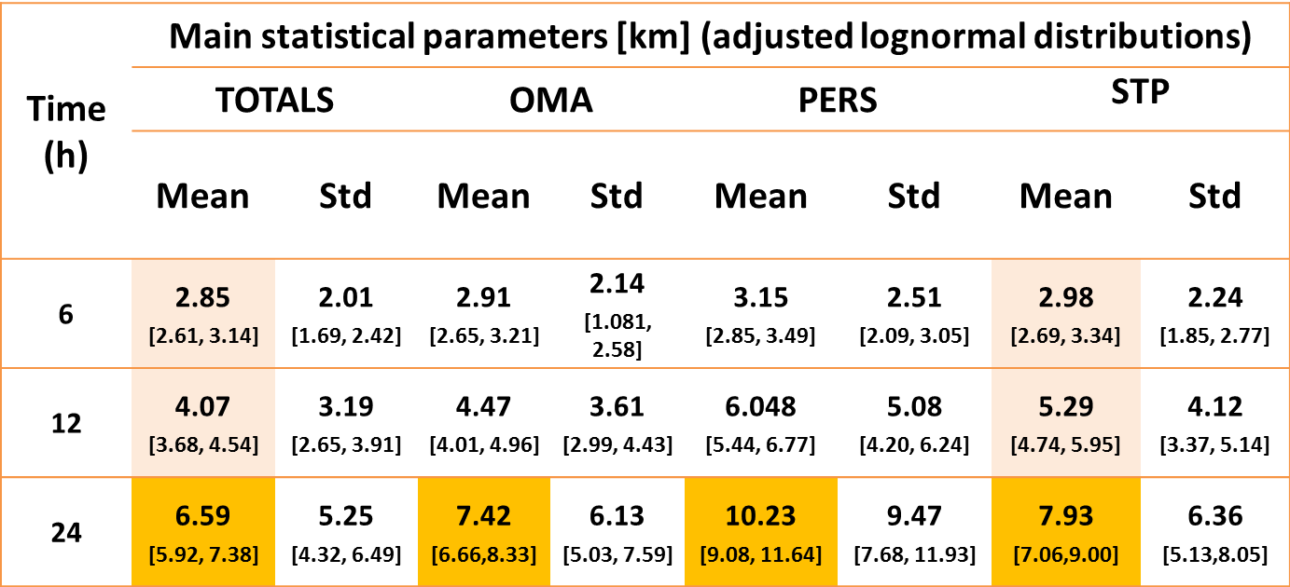
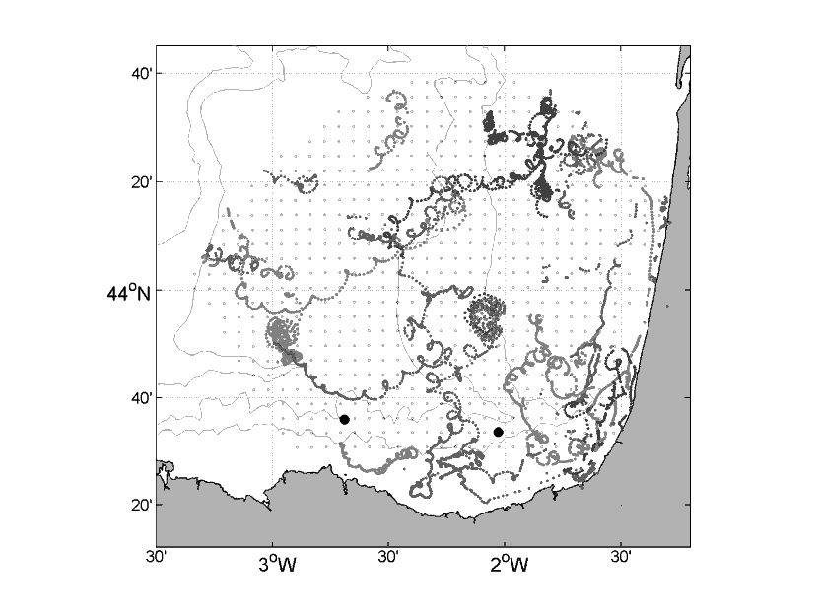
WP3: HFR Products development
Solabarrieta, L., Frolov, S., Cook, M., Paduan,J., Rubio, A., González,M., Mader, J., Charria, G., 2016. Skill assessment of HF radar-derived products for lagrangian simulations in the Bay of Biscay. J. Atmos. Oceanic Technol., 0, doi: 10.1175/JTECH-D-16-0045.1

Slide 20
WP4: HFR Node
HFR Data Center
(data production)
HFR Node
HFR Distribution Unit
HFR Data Production:
Data Production: run HFR site or assemble HFR data
Quality control: apply automatic quality controls that have been agreed
HFR Node:
Acquire Data: gather available HF Radar data though collaboration with regional and national partners.
  If the data provider can set up the data flow according the defined standards, the regional coordinator only has to link and include the new catalogue and data stream
  If the data provider cannot setup the data flow (because of lack of experience, technical capacity etc), the regional coordinator has to work on harvesting the data from the provider, harmonize and format these data and make them available from the regional catalogue
Data format and naming harmonization
Validation/Assessment: Assess the consistency of the data over a period of time and an area to detect data that are not coherent with their neighbors but could not be detected by automatic QC.
HFR Distribution Unit:
Distribution Unit: assemble data into an integrated dataset and uniform catalogue, make the data available in NRT within the European infrastructures and to the external users.

Slide 21
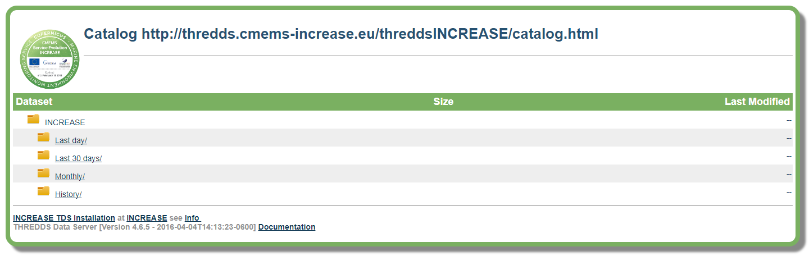
WP4: HFR Node
  Data infrastructure:
  THREDDS data server + CMEMS INSTAC naming conv
    Last day - RR_LATEST_XX_CODE_YYYYMMDD.nc
    Latest - RR_LATEST_XX_CODE.nc
    Monthly - RR_YYYYMM_XX_CODE.nc
    History - RR_YYYY_XX_CODE.nc
    (e.g. IR_2016_TL_HR_BasqueHFR.nc )

Slide 22
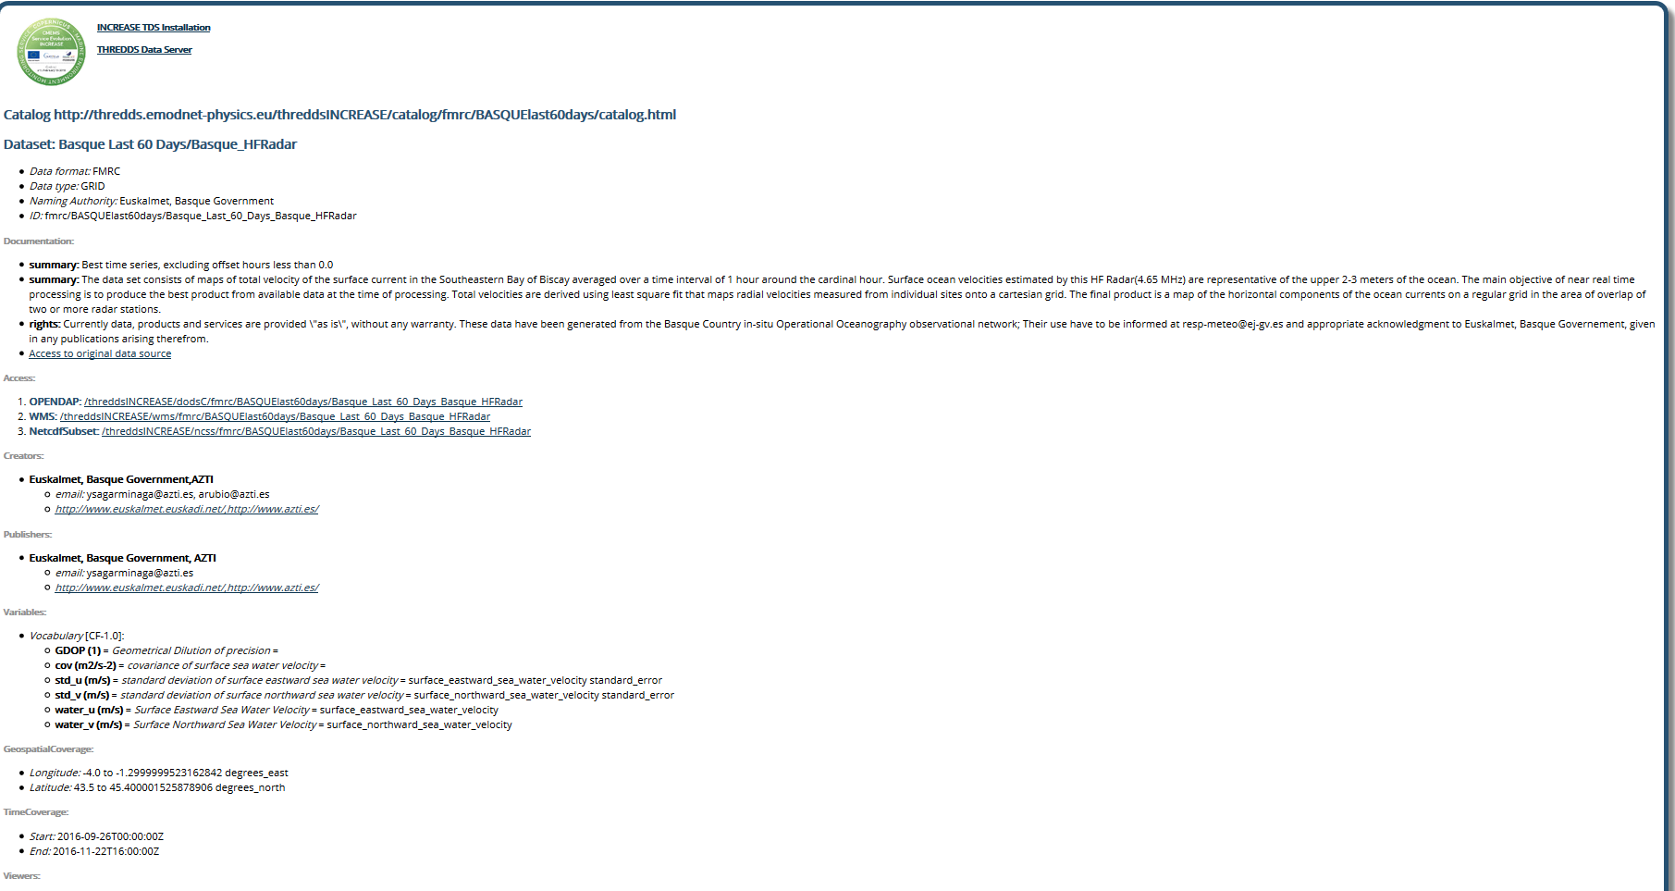
WP4: HFR Node
Details of the INCREASE THREDDS catalogue for a given platform – last 60 days

Slide 23
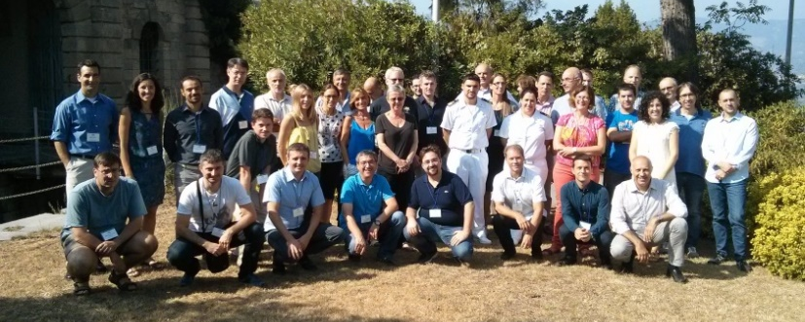
HF Radar expert workshop
La Spezia, Italy
13th-15th September 2016
47 people
NAME | INSTITUTION
Simone Cosoli | ACORN (Australian COastal Radar Network )
Julien Mader | AZTI
Anna Rubio | AZTI
Jose Luis Asensio | AZTI
Angélique Melet | CMEMS / Mercator Océan
Bruno Levier | CMEMS / Mercator Océan
Loic Petit De La Villeon | CMEMS instac / IFREMER
Stéphane Tarot | CMEMS instac / IFREMER
Carlo Brandini | CNR Ibimet & LaMMA Consortium
Carlo Mantovani | CNR-ISMAR
Lorenzo Corgnati | CNR-ISMAR
Annalisa Griffa | CNR-ISMAR
Maristella Berta | CNR-ISMAR
Marcello Magaldi | CNR-ISMAR
Roberta Sciascia | CNR-ISMAR
Laura Barbieri | CNR-ISMAR
Stefano Taddei | Consorzio LaMMA
Lohitzune Solabarrieta | DeustoTech
Enrico Zambianchi | DiST, Università Parthenope and CoNISMa
Pierpaolo Falco | University of Naples "Parthenope
Marco Uttieri | University of Naples "Parthenope"
Antonio Novellino | ETT
Marco Alba | ETT
Patrick Gorringe | EuroGOOS
Leif Petersen | Helzel/WERA
Johannes Schultz-stellenfleth | HZG
Jochen Horstmann | HZG
Alejandro Orfila | IMEDEA
Carlos Fernandes | Insituto Hidrografico
Maurizio Demarte | Italian Hydrographic Office
Marta Pratellesi | Italian Hydrographic Office
Cosmo Peluso | Italian Hydrographic Office
Céline Quentin | MIO
Michael Hartnett | National University of Ireland
Vlado Malacic | NIB
Branko Cermelj | NIB
Pablo Lorente | Puertos del Estado
Andrés Alonso-Martirena | Qualitas/CODAR
Jorge Sánchez | Qualitas/CODAR
Pia Andersson | SMHI
Emma Reyes | SOCIB
Adam Gauci | University of Malta (CALYPSO)
Giuseppe Ciraolo | University of Palermo (CALYPSO)
Fulvio Capodici | University of Palermo (CALYPSO)
Lucy Wyatt | University of Sheffield
Jeff Paduan | USA/IOOS, NPS
Mark Otero | USA/IOOS, Scripps
This meeting gathered EuroGOOS HFR Task Team members, CMEMS representatives, main HFR technological providers, US and Australian communities representatives and other active European HFR actors (cf. Attendance list in Annex).
The objective of the workshop was to involve that group of experts in:
reviewing the diagnostic of the present development of European HFR systems (existing systems, operators, existing products);
reviewing and setting methodologies for basic and HFR derived products;
reviewing CMEMS needs and objectives and how HF Radars can fit into them;
designing a roadmap for the establishment of a European HFR network.
https://azti.box.com/v/EuroGOOSHFRTTINCREASEexpWS

Slide 24
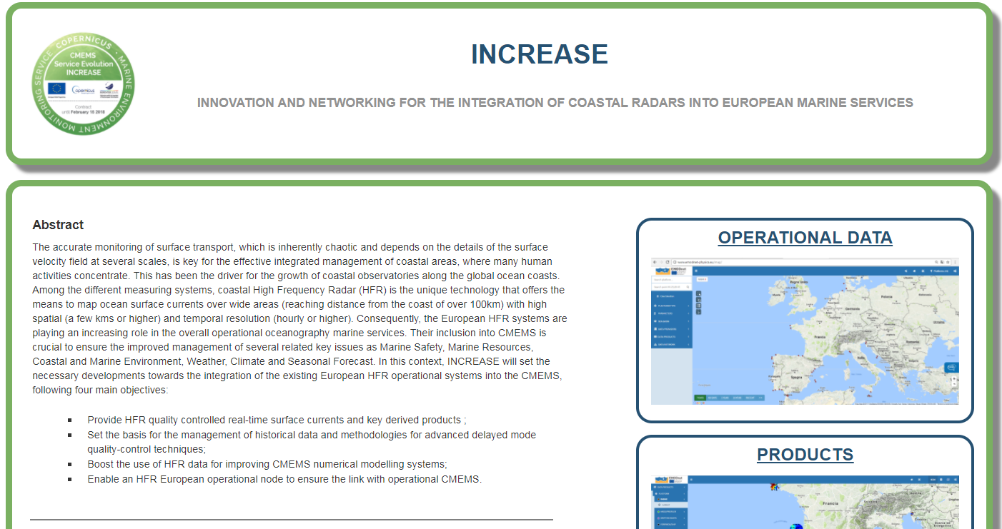
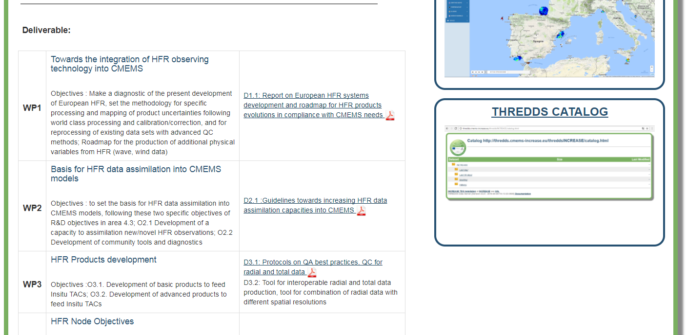
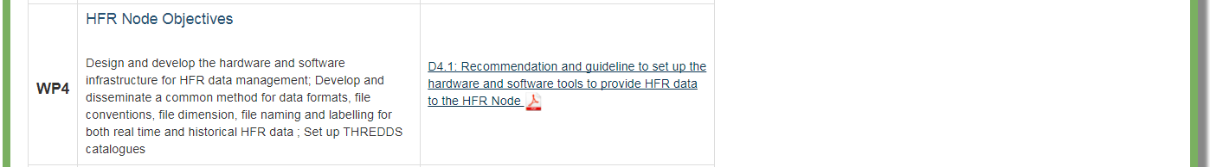
www.cmems-increase.eu

Slide 25
Potential transfer towards CMEMS 2018-2021
HFR recognized as a cost-effective solution to provide mapping of ocean surface currents over wide areas with high spatial and temporal resolution that are needed for many applications for issues related to ocean surface drift or hydrodynamical characterization.
Other R&D lines open interesting perspective for others variables like wave or surface wind data.
The basic and advanced products developed in INCREASE, based on the real-time 2D monitoring of shelf/slope surface circulation, will impact directly on key issues of CMEMS (Marine Safety, Marine Resources, Coastal & Marine Environment, Weather, Climate & Seasonal Forecast).
Direct products will be directly implemented in InSitu TAC.
Others could be used in Sea Level TAC for data intercomparison and integration, and in different MFCs for quality assessment (QUID, real-time indicators) or through data assimilation.
The covered areas allow a fundamental assessment in the buffer zones between CMEMS and downstream coastal tools.
The products based on the real-time 2D monitoring of shelf/slope surface circulation will deliver key information for assessing the boundary conditions applied in the coastal models of intermediate users.

Slide 26
Potential transfer towards CMEMS 2018-2021
The performed inventory of the operational HFR systems in Europe (Mader et al, 2016) includes 51 sites (in 20 networks) with potential impact in CMEMS.
The MFC meshes overlap so one HFR station could impact in different MFC areas.
The potential impact of the currently available data is distributed as follow: MED-MFC (17 stations), IBI-MFC (9 stations), NWS-MFC (3 stations).
INCREASE is already connecting
MED-MFC (6 stations), IBI-MFC (5 stations), NWS-MFC (1 stations).
Countries like Portugal, France or UK are establishing plans for developing their networks.
Key new systems for the European Network (on going work)

Slide 27
INCREASE: Innovation and Networking for the integration of Coastal Radars into European mArine SErvices
Thank you for your attention!
THE COPERNICUS MARINE WEEK
Brussels,
26 September 2017
DAY 2 Session
9:00-13:00
HF Radar in Europe
References and communication
Rubio A, Mader J, Corgnati L, Mantovani C, Griffa A, Novellino A, Quentin C, Wyatt L, Schulzstellenfleth J, Horstmann J, Lorente P, Zambianchi E, Hartnett M, Fernandes C, Zervakis V, Gorringe P, Melet A and Puillat I (2016) HF Radar Activity in European Coastal Seas: Next Steps Towards a Pan-European HF Radar Network. Front. Mar. Sci. 4:8. doi:10.3389/fmars.2017.00008
Mader J., Rubio A., Asensio J.L, Novellino A., Alba M., Corgnati L., Mantovani C., Griffa, A., Gorringe P., Fernandez V. (2016). The European HF Radar Inventory, EuroGOOS publications
Mader, J., Rubio, A., Griffa, A., Mantovani, C., Corgnati, L., Novellino, A., Schulz-Stellenfleth, J., Quentin, C., Wyatt, L., Ruiz, M.I., Lorente, P., Hartnett, M., Gorringe, P. “Joint Efforts Towards European HF Radar Integration” was presented in the session “OS13B Toward an International Coastal Ocean Radar Network: Technology Development, Research Demonstration, and Operational Applications II Posters” of the AGU- Fall Meeting, San Francisco, USA, 12 December 2016. Poster available at: https://agu.confex.com/agu/fm16/mediafile/Handout/Paper174583/poster_AGU_vf.pdf
A. Rubio participated in the French Renhfor project meeting, giving an update of INCREASE results and the progress towards a unified HFR European network. Brest, 27 October 2016.
A. Rubio participated in the 5th Meeting of the GEO Global HF Radar Task held in San Francisco, USA, on the 12th December 2016. Agenda of the meeting and presentations to be published soon at: https://rucool.marine.rutgers.edu/geohfr/meetings.html.
C. Mantovani and L. Corgnati have attended the ROWG meeting to show INCREASE progress and exchange on methodologies for data processing and QA/QC https://www.cpaess.ucar.edu/sites/default/files/meetings/2017/documents/Agenda%20ROWG%202017.pdf), held in Texas A&M University, Galveston, (Texas)
CMEMS Service Evolution 21-SE-CALL1
Lot5: INCREASE project
Innovation and Networking for the integration of Coastal Radars into European mArine SErvices

